Slide 1
Sorting Algorithms
Marek Darsa
3.11.2023

Slide 2


Slide 3
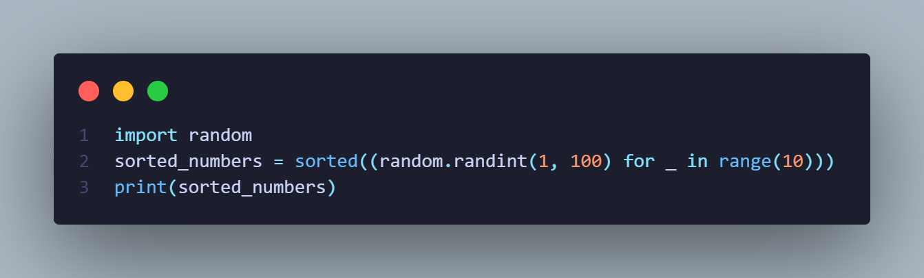
Sort algorithm in python

Slide 5
What is a sorting algorithm?
Sorting algorithms are a set of instructions for arranging data into a specific order
Numerical and Alphabetical
Ascending and Descending

Slide 6
What are sorting algorithms used for
Sorting algorithms are used for rearranging large amounts of data
To boost efficiency of programs
Essential in data processing

Slide 7
A case of use from real world
Databases: you can sort data by id, alphabet, date and much more
In Search engines: you can find more quickly what you are searching
Science applications: you can work with Big Data more easily.

Slide 8
Time and Space complexity
Time complexity->how much time is needed to sort data
Space complexity ->how much space is needed to sort data
Bubble sort: O(n^2) , O(1)
Merge sort: O(n/log(n)) , O(n)

Slide 9
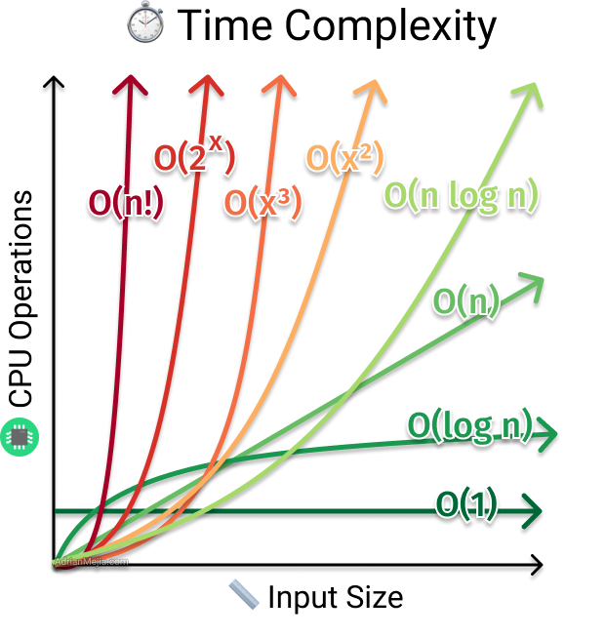

Slide 10
Selection sort
Time complexity: O(n^2)
Space complexity: O(1)

Slide 11
Selection sort
Dividing into Sorted and Unsorted Parts: Initially, the entire list is considered unsorted. The algorithm maintains two sublists within the input list: the left part represents the sorted portion, and the right part is the unsorted portion.
Selecting the Minimum (or Maximum) Element: The algorithm begins by searching for the minimum (or maximum) element in the unsorted portion of the list. To do this, it iterates through the unsorted portion and keeps track of the index of the minimum (or maximum) element found so far.
Swapping: Once the minimum (or maximum) element is found, it is swapped with the first element in the unsorted portion. This effectively moves the selected element from the unsorted portion to the end of the sorted portion.
Expanding the Sorted Portion: The algorithm then considers the left part (sorted portion) to have expanded by one element, and the right part (unsorted portion) to have shrunk by one element.
Repeat: Steps 2 to 4 are repeated for the remaining elements in the unsorted portion. The algorithm continues to find the minimum (or maximum) element from the remaining unsorted elements and swaps it with the first element in the unsorted portion.
Termination*: The algorithm repeats this process until the entire list is sorted. At this point, the unsorted portion becomes empty, and the sorted portion contains all the elements in the correct order.

Slide 12
Bubble sort
Time complexity: O(n^2)
Space complexity: O(1)

Slide 13
Bubble sort
Comparing and Swapping: Bubble Sort works by repeatedly comparing adjacent elements in the list and swapping them if they are in the wrong order. It starts at the beginning of the list.
Passes Through the List: In each pass through the list, Bubble Sort compares adjacent pairs of elements and swaps them if they are out of order. After each pass, the largest (or smallest, depending on the sorting order) element "bubbles up" to its correct position at the end of the list.
Repeat Until Sorted: Bubble Sort continues making passes through the list until no more swaps are needed. This indicates that the list is completely sorted. Bubble Sort is known for its "bubbling" of the largest (or smallest) elements to their correct positions in each pass.

Slide 14
Insertion sort
Time complexity: O(n^2)
Space complexity: O(1)

Slide 15
Insertion sort
Dividing into Sorted and Unsorted Parts: Similar to Selection Sort, Insertion Sort divides the list into two parts: the left part represents the sorted portion, and the right part is the unsorted portion. Initially, the first element is considered the sorted portion, and the rest of the list is the unsorted portion.
Inserting Elements: Insertion Sort works by taking one element at a time from the unsorted portion and inserting it into its correct position within the sorted portion. The algorithm starts with the second element (index 1) because a single element is always considered sorted.
Comparing and Shifting: To insert an element into the sorted portion, the algorithm compares it with the elements in the sorted portion from right to left. It shifts elements in the sorted portion to the right to make room for the new element until the correct position is found.
Repeat: Steps 2 and 3 are repeated for each element in the unsorted portion, gradually expanding the sorted portion and reducing the unsorted portion.
Termination: The algorithm continues these steps until the entire list is sorted. At this point, all elements are in their correct positions.

Slide 16
Quick sort
Time complexity: O(n log(n))
Space complexity: O(n)

Slide 17
Quick sort
Choosing a Pivot: Quick Sort begins by selecting a "pivot" element from the list. The choice of the pivot can significantly affect the algorithm's performance. Common pivot selection strategies include choosing the first element, the last element, the middle element, or a randomly selected element.
Partitioning: The main idea behind Quick Sort is to rearrange the elements in the list such that all elements smaller than the pivot are on the left side, and all elements greater than the pivot are on the right side. This process is called partitioning.
The pivot element is placed in its final sorted position.
Elements smaller than the pivot are moved to the left of the pivot.
Elements greater than the pivot are moved to the right of the pivot.
Recursion: After the partitioning step, the list is divided into two sublists: one containing elements smaller than the pivot and another containing elements greater than the pivot. Quick Sort is applied recursively to both of these sublists.
Termination: The recursion continues until the sublists are empty or contain only one element, as a single element or an empty list is already considered sorted.

Slide 18
Heap sort
Time complexity: O(n log(n))
Space complexity: O(1)

Slide 19
Heap sort
The first step in Heap Sort is to create a binary heap from the input list. This binary heap can be either a max-heap or a min-heap, depending on whether you want to sort the list in ascending or descending order. The heapify operation ensures that the heap property is maintained, which means that the parent node is greater (in a max-heap) or smaller (in a min-heap) than its child nodes.
Heap Sort Algorithm:
The root of the heap contains the largest (in a max-heap) or smallest (in a min-heap) element. Swap this root element with the last element in the list.
Remove the last element (which is now in its correct position) from the heap.
Re-heapify the remaining elements in the heap to maintain the heap property.
Repeat the above steps for the remaining elements in the heap until the entire list is sorted.

Slide 20
Merge sort
Time complexity: O(n log(n))
Space complexity: O(n)

Slide 21
Merge sort
Divide: The unsorted list is divided into two equal-sized sublists (or approximately equal-sized if the number of elements is odd). This division continues recursively until the sublists are reduced to single elements.
Conquer: At the base case, when the sublists contain only one element, they are considered sorted by definition. The algorithm then starts merging these smaller sorted sublists back together.
Merge: The merging process begins by comparing the first element of each sublist. The smaller (or larger, depending on the sorting order) element is placed into a new list. The comparison and merging continue until all elements from the two sublists are merged into the new list. This new list is now considered a sorted sublist.
Recursion: The merge step is applied recursively until all sublists are merged into a single sorted list.

Slide 22
Bucket sort
Time complexity: O(n+k)
Space complexity: O(n+k)

Slide 23
Bucket sort
Determine the Range: Bucket Sort requires knowledge of the range of values in the input list. Determine the minimum and maximum values in the list to define the range.
Create Buckets: Divide the range of values into a set of equal-sized intervals or buckets. The number of buckets to use is a design choice, but it's typically chosen to be proportional to the number of elements in the list.
Distribute Elements: For each element in the input list, determine which bucket it belongs to based on its value. Place each element into its corresponding bucket.
Sort the Buckets: Sort each individual bucket. This can be done using any suitable sorting algorithm, such as Insertion Sort, Quick Sort, or another stable sorting method. The choice of sorting algorithm can depend on the size of the buckets and the distribution of data within them.
Concatenate Buckets: Combine the sorted buckets to obtain the final sorted list. The order of concatenation depends on the ordering of the buckets and their contents. This step can be done efficiently using various techniques.

Slide 24
Types of sorting
Comparison-based sorting algorithms
Non-comparison-based sorting algorithms
In-place sorting algorism
Stable sorting algorithms
Adaptive sorting algorithms

Slide 25
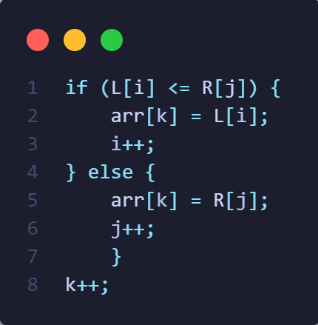
Comparison-based sorting algorithms
Compare elements
Merge sort

Slide 26
Non-comparison-based sorting algorithms
Don’t compare elements
Bucket sort

Slide 27
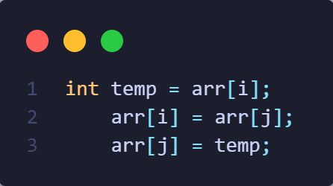
In-place sorting algorism
Don’t need more space
Quick sort

Slide 28
Stable Sorting Algorithms
Sort every element
Merge sort

Slide 29
Adaptive sorting algorithms
Sort only elements that need to be sorted
Bubble sort

Slide 30
Sorting Algorithms Animations | Toptal®

Slide 31


Slide 32
Thanks for your attention Questions?

